Slide 1
Elliptic Curve Cryptography For Wireless Sensor Networks
Project ID: 09
Team Members:
S.M.Aravinth
Ajey D Rathan
Ajith Kumar Dasari
Guide name: Prof. S.Rajendran

Slide 2
Paper / Material Reference
Title:
Routing Driven Elliptic Curve Cryptography Based key Management For Heterogeneous Sensor Networks
Authors:
Xiaojiang Du, Mohsen Guizani, Yang Xiao, Hsiao- Hwa Chen
Journal / Conf. Name:
IEEE Transactions On Wireless Communications
Vol. #8

Slide 3
Paper / Material Reference
NS manual and tutorial.
Cryptography Theory and Practice – Stinson.
Modern Cryptography – Mao.

Slide 4
ABSTRACT
We propose the utilization of Elliptic Curve Cryptography in the design of an efficient data encryption/decryption system for sensor nodes in a wireless network.
Elliptic Curve Cryptography can provide impressive levels of security standards while keeping down the cost of certain issues , primarily storage space.
Sensors will benefit from having to store relatively smaller keys coupled with increased computational capability and this will be a stronger design as the bit-level security is improved.

Slide 5
Proposed System
We propose using a Elliptic Curve based cryptography scheme to make use of the smaller key sizes characteristic of such cryptosystems.
We focus on a wireless simulation due to the extensive deployment of sensors in such environments.
Sensors are devices of small technological capability but their enormous usage can amplify small gains , thus decreasing the key storage capacity for example has a large effect on the overall system.

Slide 6
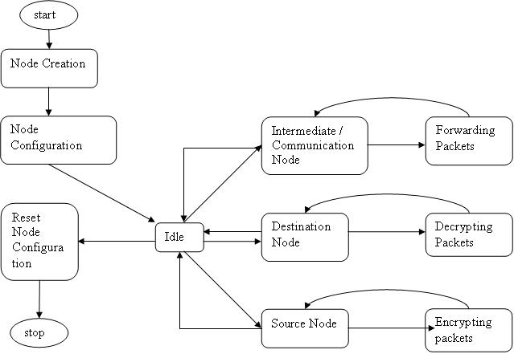
STATE DIAGRAM FOR NODES

Slide 7
FLOW DIAGRAM
Node Configuration
Set packet format
protocol
Encryption
node
Data parameter set
node
Packet sent
protocol
Packet received/buffered
node
Decryption
node

Slide 8
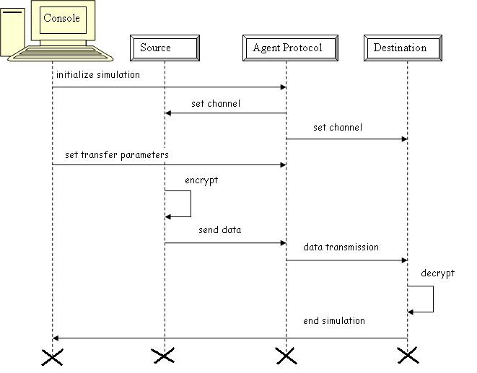
SEQUENCE DIAGRAM

Slide 9
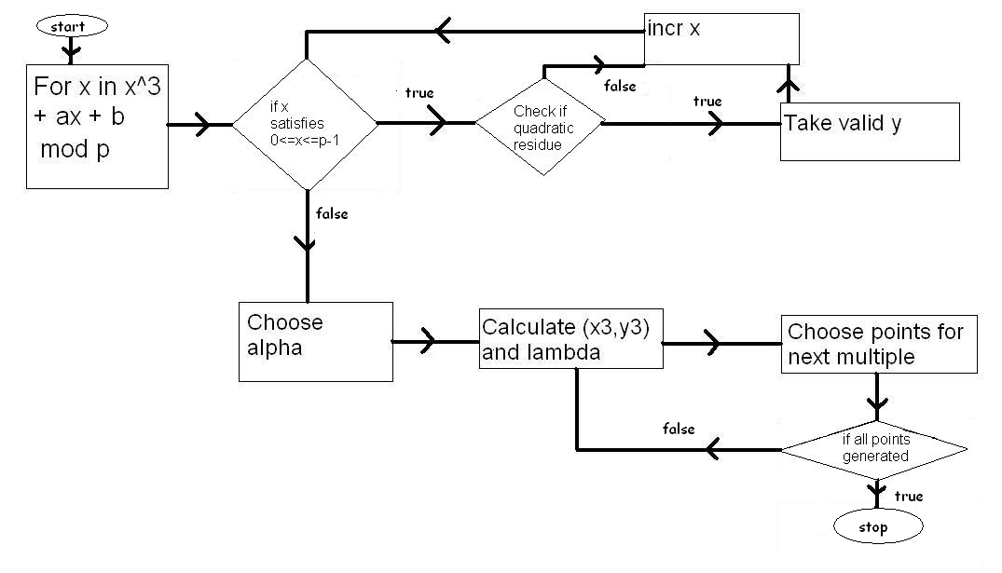
FLOW CHART TO GENERATE POINTS ON THE ELLIPTIC CURVE

Slide 10
ECC PSEUDOCODE TO GENERATE POINTS
For an elliptic curve y ² =x³+ax+b find points (x,y) that satisfy y² ≡ x³+ax+b mod p
For each 0<= x <=p-1, find mod p of x³+ax+b
Apply Quadratic Residue property to determine valid y points for x.
Choose the generator point α
Generate multiples of α using λ.
Calculate λ=(y2-y1)(x2-x1) ˉ¹ , if P!=Q
λ=(3x1²+a)(2y1) ˉ¹ , if P=Q
Calculate x3= λ²-x1-x2
y3= λ² (x1-x3)-y1

Slide 11
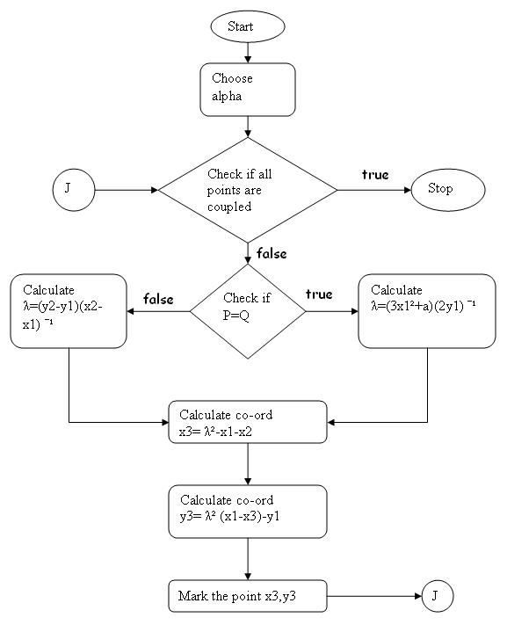
Flowchart for Point Multiples

Slide 12
Quadratic Residue check:
p is an odd prime, a is an integer
Check1 : (0-a) mod p != 0
Check2 : y² ≡ a mod p and 0<=y<=p-1
Point Compress:
PointCompress(P)=(x,y mod 2)
Point Decompress:
Z = x³+ax+b mod p for point (x,i)
Check if Z is a Quadratic Residue
y ≡ Z^½ mod p
If y ≡i mod 2 then return(x,y) else return (x,p-y)

Slide 13
ECIES PSEUDOCODE
Encryption:
Get public key of Bob-> private key * P
Choose random k, calculate kP
Calculate kQ
Set x0 from kQ
Calculate y1=PointCompress(kP)
Calculate y2=x * x0 mod p where x=Alice’s data value
Ciphertext y=(y1,y2)

Slide 14
Decryption:
Calculate PointDecompress(y1)
Multiply resultant with private-key
Take resultant x co-ordinate value as x0
Calculate y=y2 * (x0) ˉ¹ mod p

Slide 15
Integration into NS
Agents are used to emulate protocols.
We create an agent under existing agent class to use the cryptosystem.
We need to place the cryptosystem in the agent.
NS is recompiled to incorporate the agent.

Slide 16
Creating An Agent
Agent packet type id and reference identifier entries are made in packet.h.
The id reference is declared in the ns-default.tcl and ns-packet.tcl files.
The agent is created and the directory object file is inserted into the Makefile's object list.
Recompile NS to check for integration.

Slide 17
Software
Operating System: Linux
Simulator : NS/2
Programming: C++ , TCL (Tool Command Language)
Hardware
Processor : Pentium IV 2.6 GHz
RAM : 512 MB DD RAM
Monitor : 15” color
Hard disk : 40 GB
CD- drive : yes

Slide 18
Coding standards / Best practices adopted
TCL ( Tool Command Language ) programming was carried out as shown through NS2 tutorials.
C++ coding for ECC is formatted.

Slide 19
THANK YOU!

